Slide 1
Laplacian Matrix, Matrix Factorization Graph Embeddings and Graph-based Semi-supervised Learning
Yupei Du

Slide 2

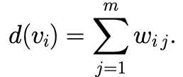

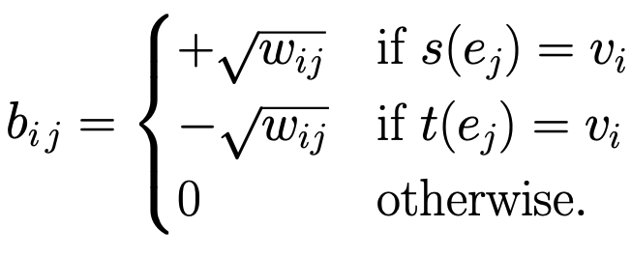
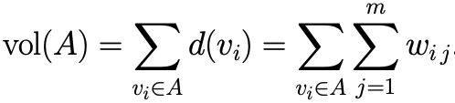
Laplacian Matrix
Given , adjacency matrix
We have
incidence matrix
Volume

Slide 3
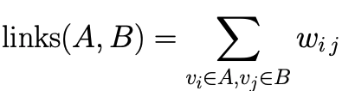

Laplacian Matrix
Random Walk Laplacian

Slide 4
Matrix Factorization Graph Embeddings

Slide 5
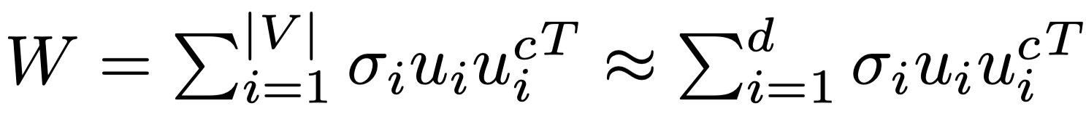
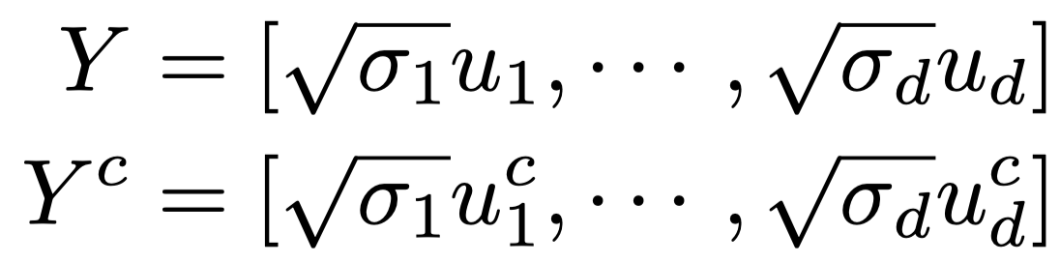
Matrix Factorization Graph Embeddings
Deep Learning methods (Deep walk, tranE, autoencoder…)

Slide 6
Spectral Clustering
Similarity matrix
Find minimum cuts (problem)

Slide 7
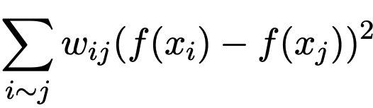
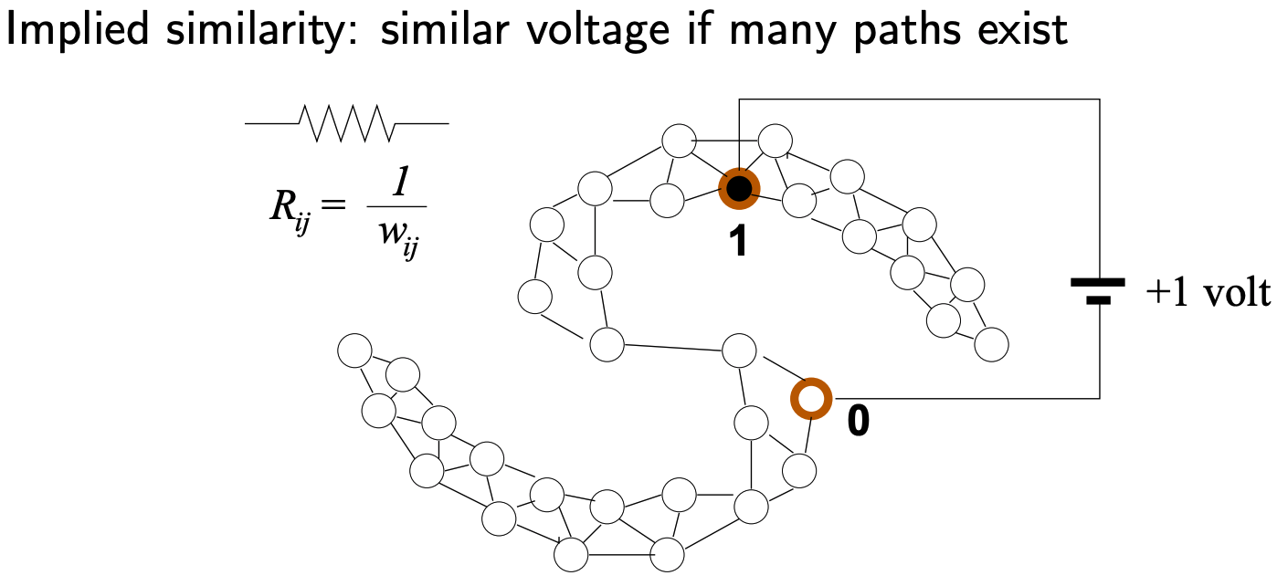
Graph-Based Semi-Supervised Learning
Harmonic function

Slide 8
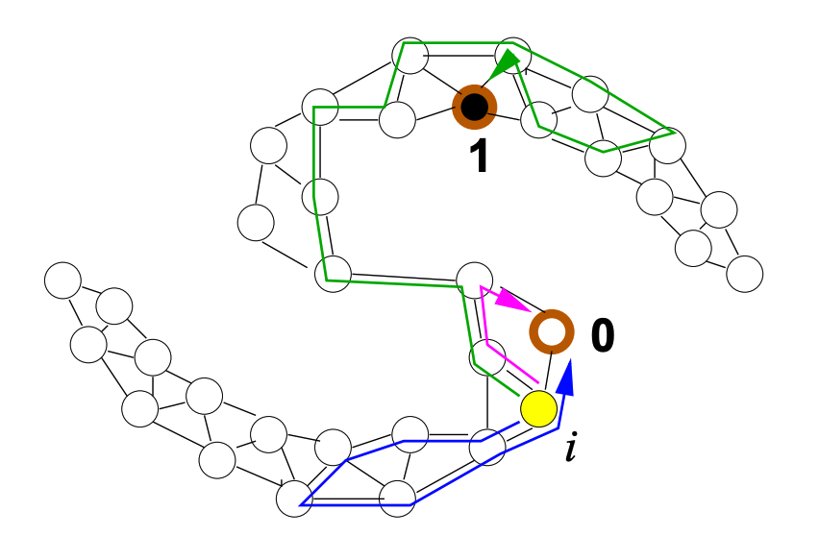
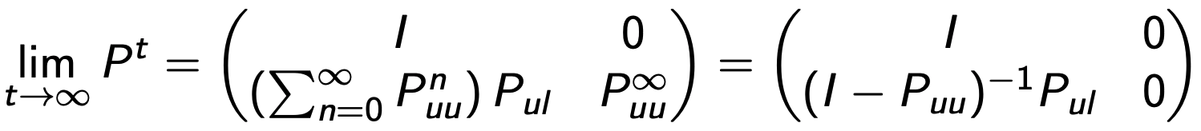
Graph-Based Semi-Supervised Learning
Random Walk
Stop if we hit a labeled node

Slide 9
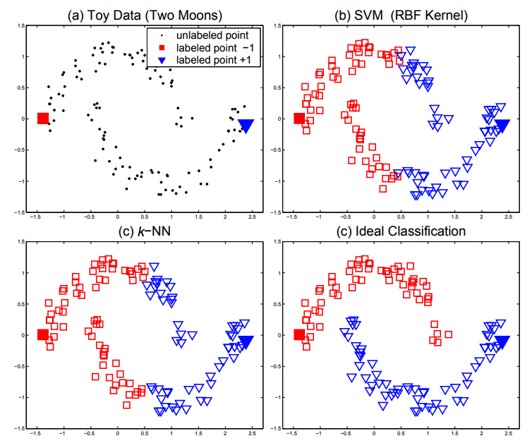
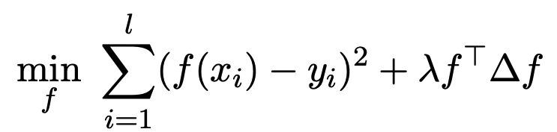
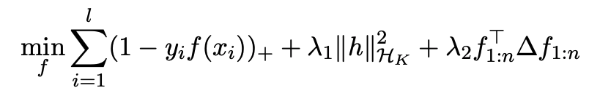
Graph-Based Semi-Supervised Learning
Local and global consistency
Manifold regularization

Slide 10
Advantages
Clear mathematical framework
Performance is strong if the graph happens to fit the task
The inverse of the Laplacian can be viewed as a kernel matrix

Slide 11
References
http://pages.cs.wisc.edu/~jerryzhu/pub/sslicml07.pdf
http://www.leonidzhukov.net/hse/2015/networks/lectures/lecture17.pdf
http://www.cis.upenn.edu/~cis515/cis515-14-graphlap.pdf
https://www.cnblogs.com/pinard/p/6221564.html
[NIPS04] Learning with Local and Global Consistency
[ICML03] Semi-supervised learning using Gaussian fields and harmonic functions
[JMLR06] Manifold regularization: A geometric framework for learning from labeled and unlabeled examples
[TKDE17] A Comprehensive Survey of Graph Embedding: Problems, Techniques and Applications

